Slide 1
Building Mashups
Craig Knoblock
University of Southern California
Thanks to Pedro Szekely, Shubham Gupta, and Rattapoom Tuchinda for earlier versions of the slides

Slide 2
A mashup is a Web page or application that uses and combines data, presentation or functionality from two or more sources to create new services
wikipedia.org

Slide 3
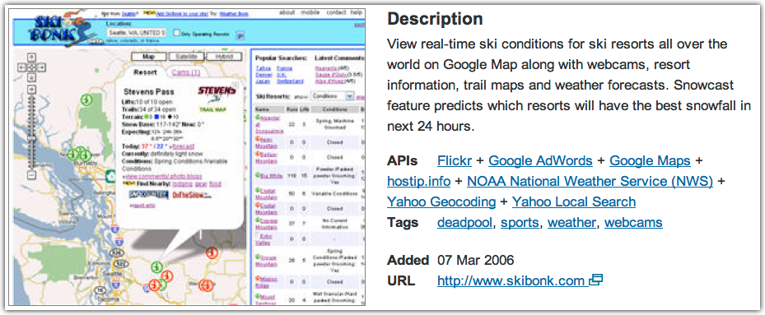
Ski Bonk
programmableweb.com

Slide 4
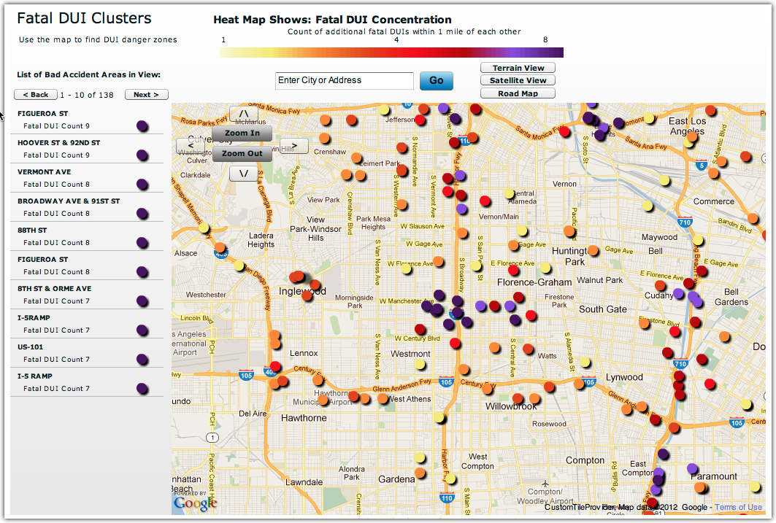
DUIMap.org

Slide 5
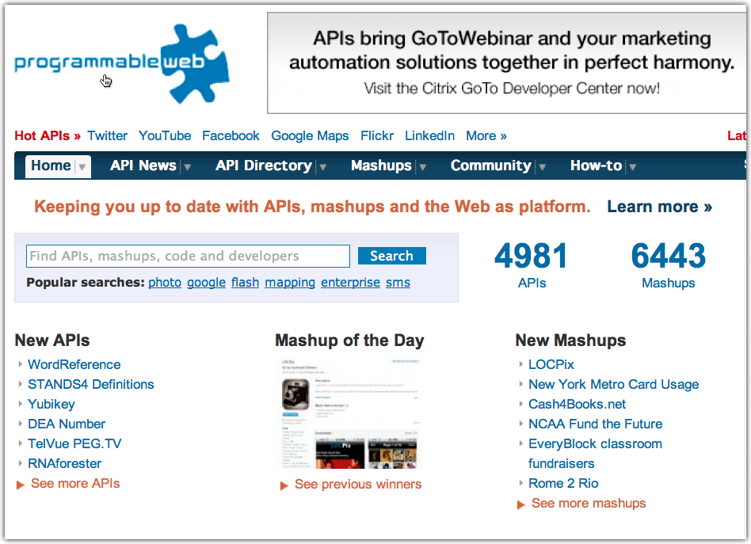
2010

Slide 6
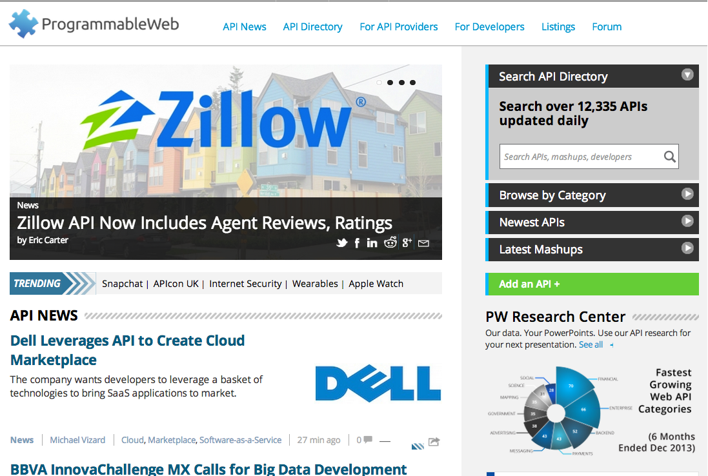
2014

Slide 7
Problem
Significant expertise to create
Demand is huge
Unique user requirements
Growing number of sources

Slide 8
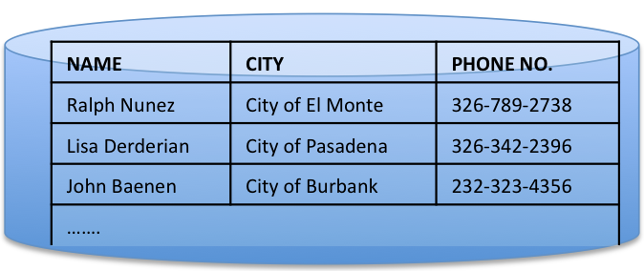
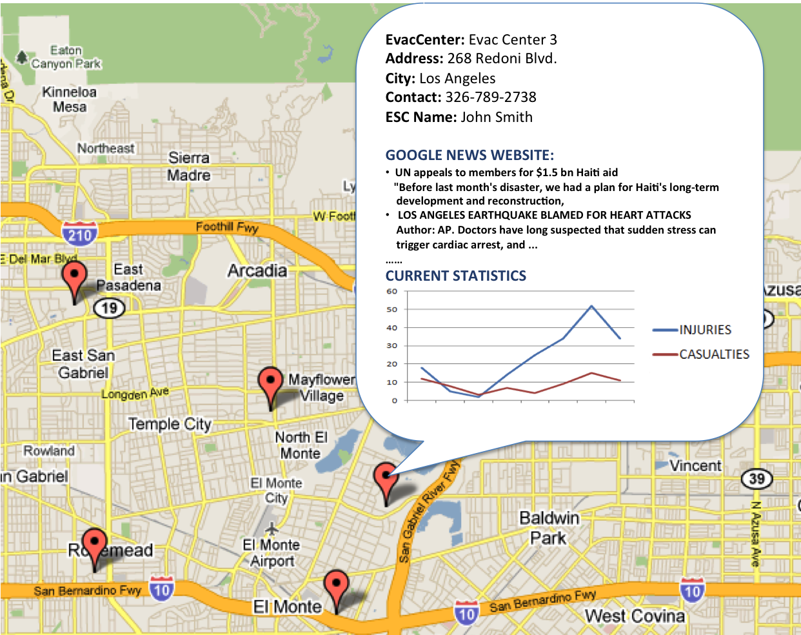
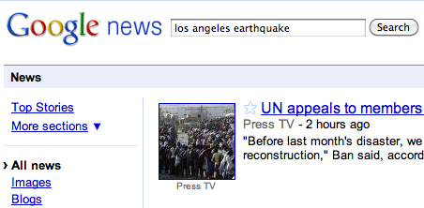
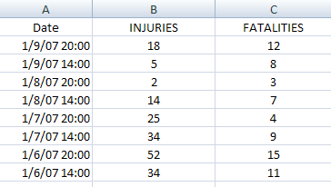
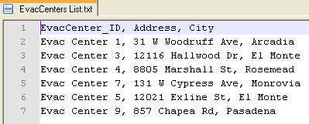
Motivation: Crisis ManageMENT
Analyst employs multiple data sources for decision-making
TIME CONSUMING APPROACH
X Managing multiple software packages
X Need to switch back and forth b/w sources
X No good data visualization may be provided
Contact Information for Emergency Coordinators from a MySQL Database
News Website
MASHUPS CAN SAVE TIME!
Only Web-browser required
Integrated view of all sources
Customize visualization as per needs
Latest Injuries Statistics in Excel Spreadsheet
Evacuation Centers List in CSV Text File

Slide 9
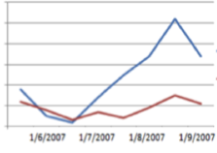
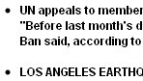
Mashup Building Issues
Evacuation Centers
CSV Text File
Emer. Coordinator
MySQL DB
Injury statistics in
Excel Spreadsheet
Google News Website
DATA RETRIEVAL
Extract
Extract
Extract
Extract
{Name, City,
Phone No.}
SOURCE MODELING
{EvacCenter_ID,
Address, City}
{Date, Injuries,
Fatalities}
{Headlines, Summary,
Date, Link}
DATA CLEANING
Clean
DATA INTEGRATION
{EvacCenter_ID, Address, City
, Name, Phone No.}
DATA VISUALIZATION
Visualize as chart
Visualize as bulleted list
MAP

Slide 10
Outline
Interactive Extraction Specification
Interactive Integration Specification
Widget-based Approach to Integration
Programming by demonstration

Slide 11
Outline
Interactive Extraction Specification
Interactive Integration Specification
Widget-based Approach to Integration
Programming by demonstration

Slide 12

Piggybank
Scrape RDF as you browse
Contribute RDF to the community
Leverage community RDF
Add tags to your or other people’s RDF
Integrate via RDF
Faceted RDF browsing

Slide 13

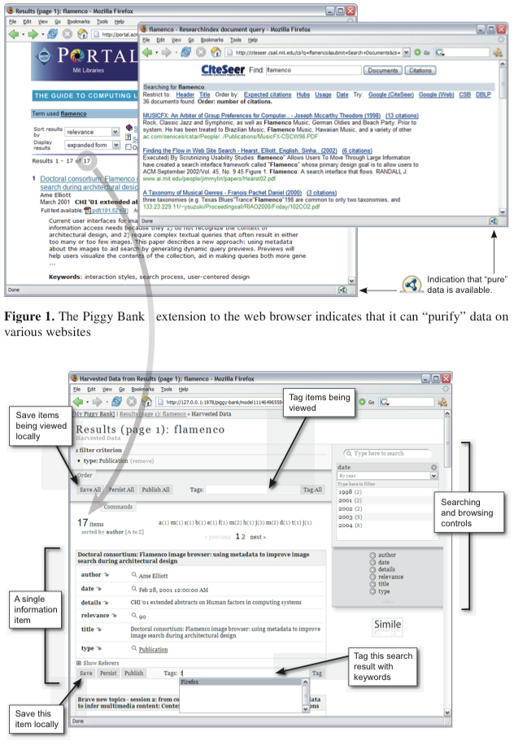

Browsing along, collecting data from multiple sites ….

Slide 14
Let’s see what I have ….

Slide 15
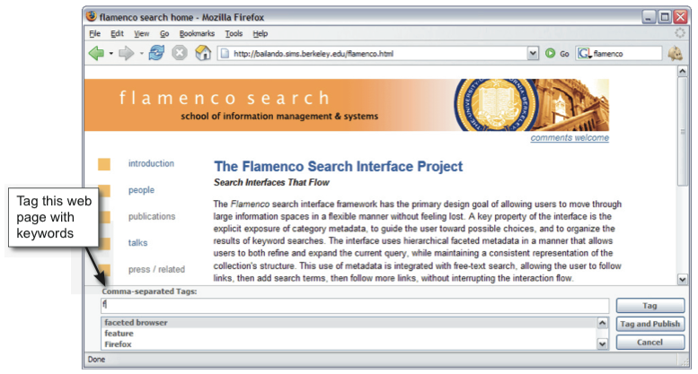
Nice, I can tag any page ….
Sure, go ahead, I save the tags as RDF

Slide 16
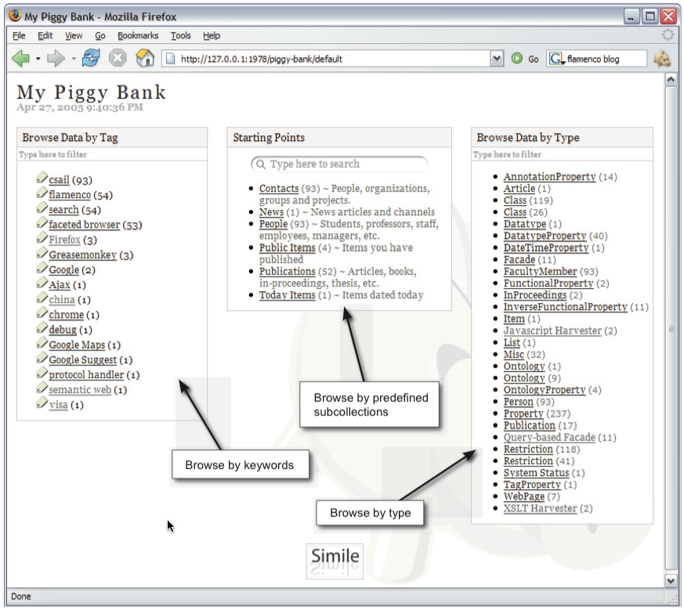
Cool Faceted Browsing. It’s so nice I put it in Google Refine
Let’s look at my Piggy Bank….

Slide 17
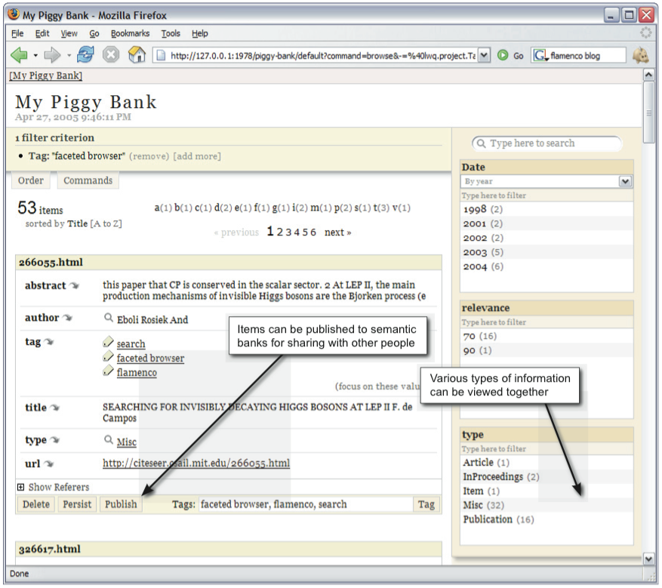
Yeah! My data is well organized no matter where it came from!
Semantic Bank? … like a BIG Piggy Bank for all?

Slide 18
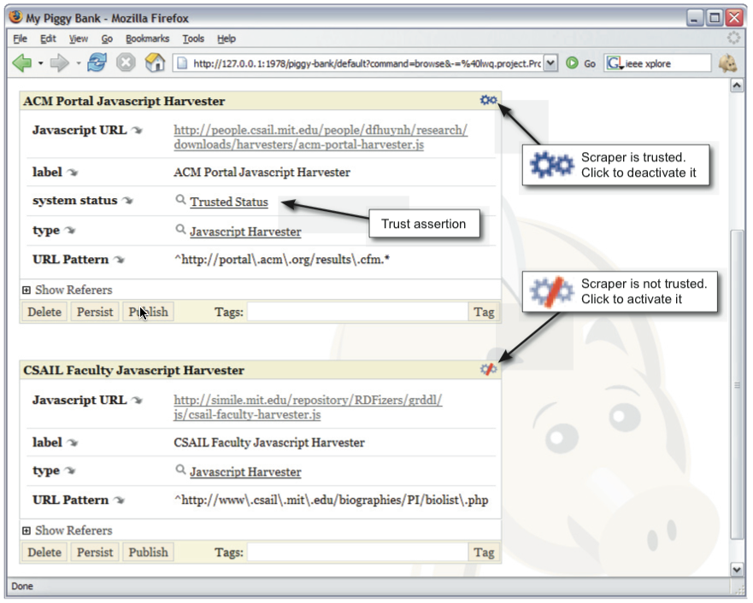

I keep Grandma safe
I make all the RDF Harvesters, Grandma doesn’t know

Slide 19
http://simile.mit.edu/solvent/screencasts/solvent_screencast.swf

Slide 20
Outline
Interactive Extraction Specification
Interactive Integration Specification
Widget-based Approach to Integration
Programming by demonstration

Slide 21
Intel Mash Maker
Multiple tiers of users
Basic > normal > skilled > semi-expert > expert > guru
Multiple tiers of mashup construction
Basic:
Click on suggested mashups created by others
Expert:
Specify how to extract and join information

Slide 22
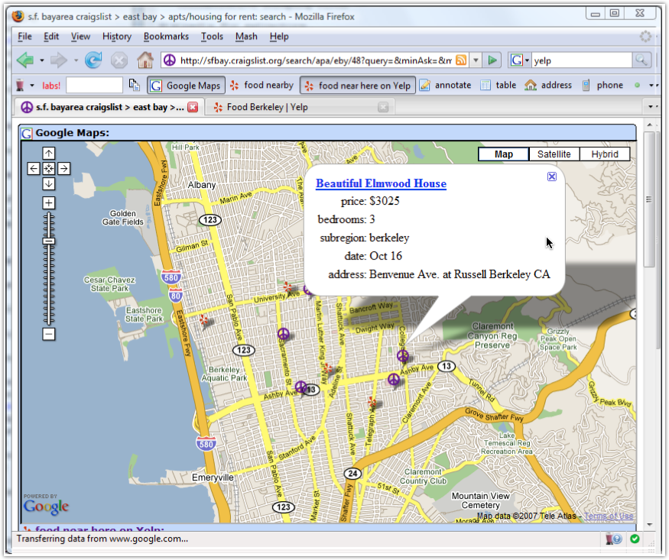
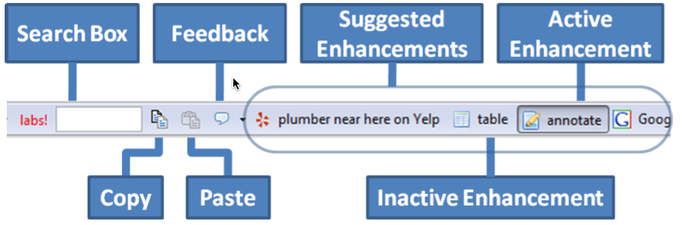
Mash Maker Toolbar

Slide 23
Suggest Enhancements
She visited YELP before,
I’ll suggest it
Others used YELP with Craigslist,
I’ll suggest it
Mash Maker

Slide 24



Intel Mash Maker Example
+
+
Apartments and close-by restaurants on a map

Slide 25
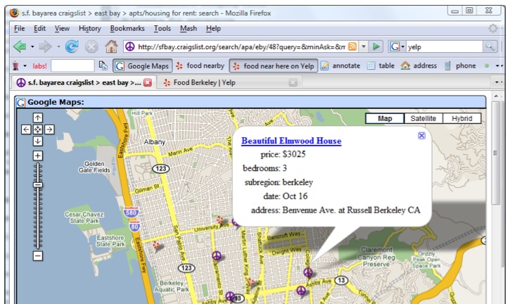
Basic Level

Slide 26

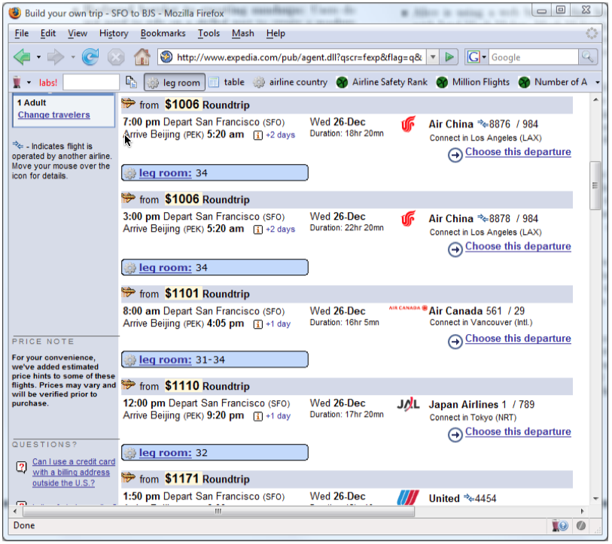
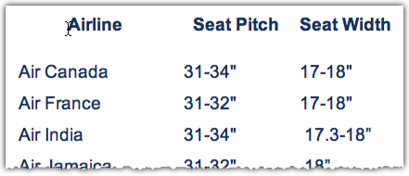

Intel Mash Maker Example
+
Expedia flights with legroom information

Slide 27
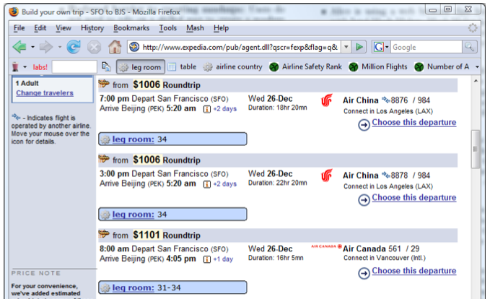
Basic Level

Slide 28
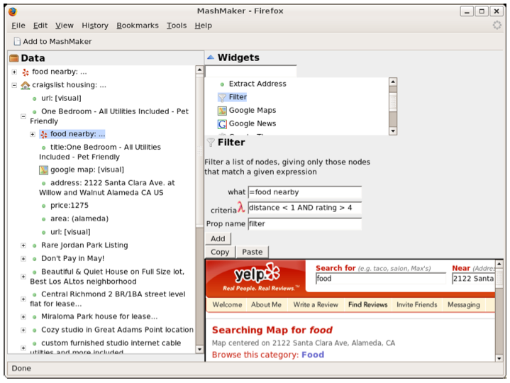
Expert Level

Slide 29
Intel Mashmaker: Design Principles
Program as you browse
Mashup creation is an extension of normal web browsing
Direct manipulation
work on data, not abstract concepts such as programs
Pay as you go
Unskilled users gain some benefit with very little effort
Experts should be able to do more advanced stuff

Slide 30
https://www.youtube.com/watch?v=YS28OjAeHUU

Slide 31
Outline
Interactive Extraction Specification
Interactive Integration Specification
Widget-based Approach to Integration
Programming by demonstration

Slide 32
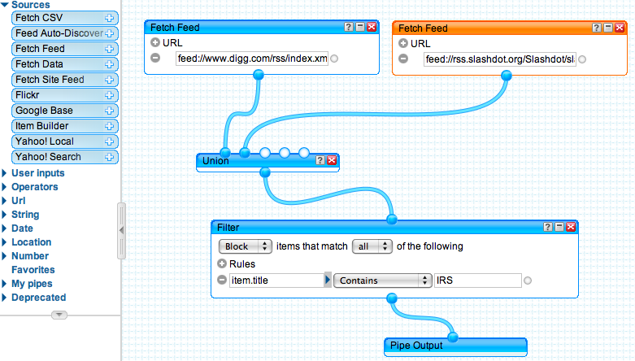
Widget-Based Approach
Data processing workflow
Widgets available for common mashup operations
Yahoo’s Pipes
Notes:
Pedro: Doesn’t translate to not having to understand programming.
How about:
- Addresses syntax issued
- But users still required to understand programming concepts

Slide 33

Yahoo! Pipes
Powerful composition tool to
aggregate, manipulate, and mashup content
from around the web
http://pipes.yahoo.com/pipes/

Slide 34
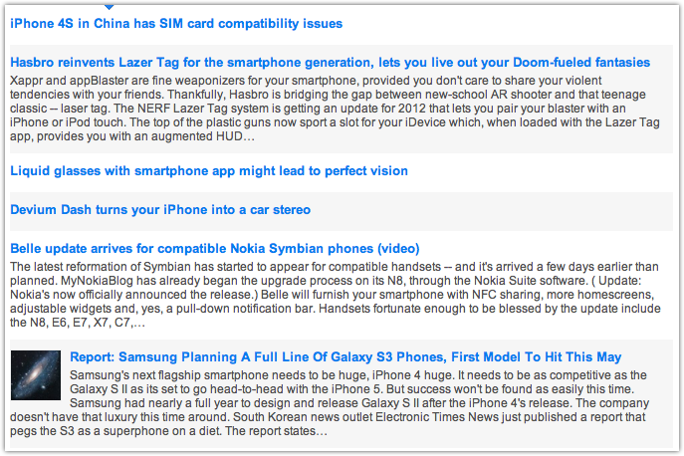
Phone stories from multiple feed providers
engadget.com/rss.xml
feeds.mashable.com/mashable
feeds.feedburner.com/ubergizmo
feeds.feedburner.com/crunchgear

Slide 35
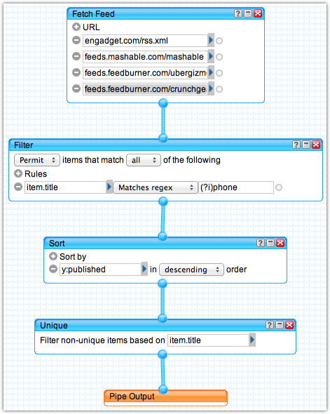
engadget.com/rss.xml
feeds.mashable.com/mashable
feeds.feedburner.com/ubergizmo
feeds.feedburner.com/crunchgear

Slide 36
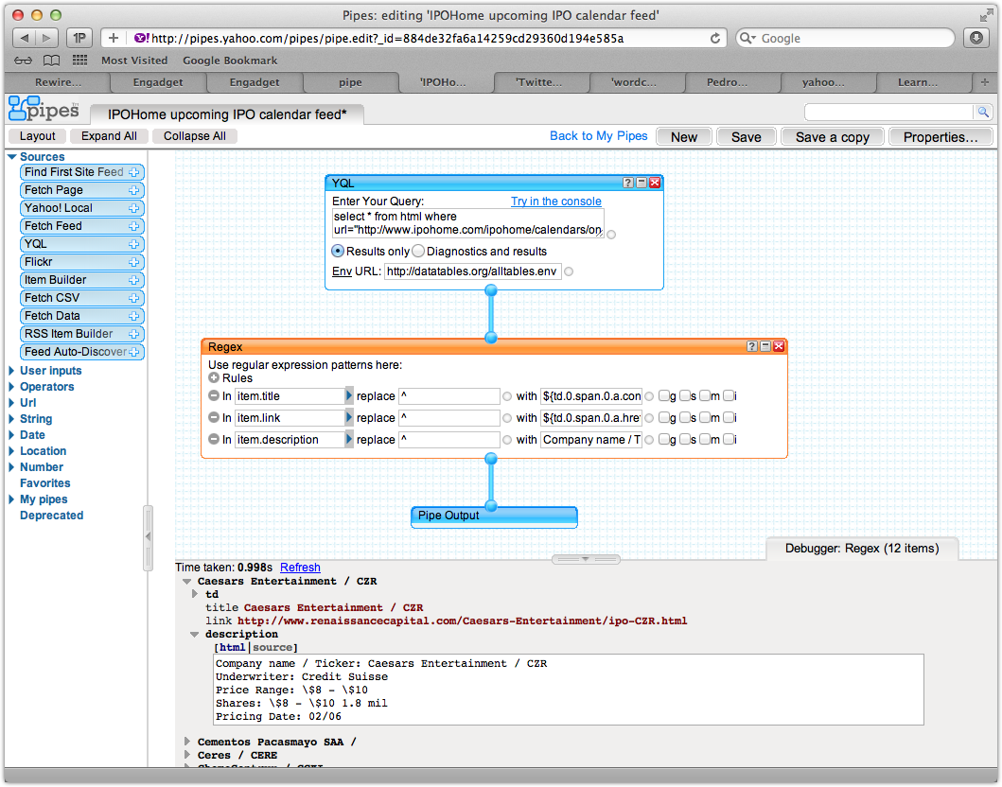

Slide 37
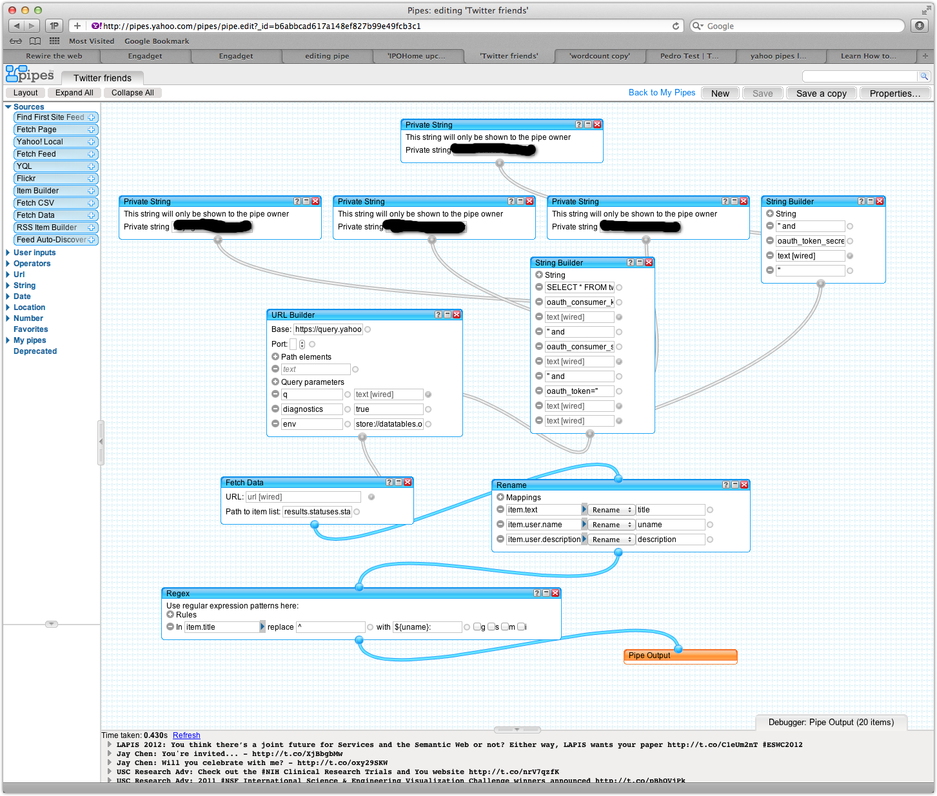

Slide 38
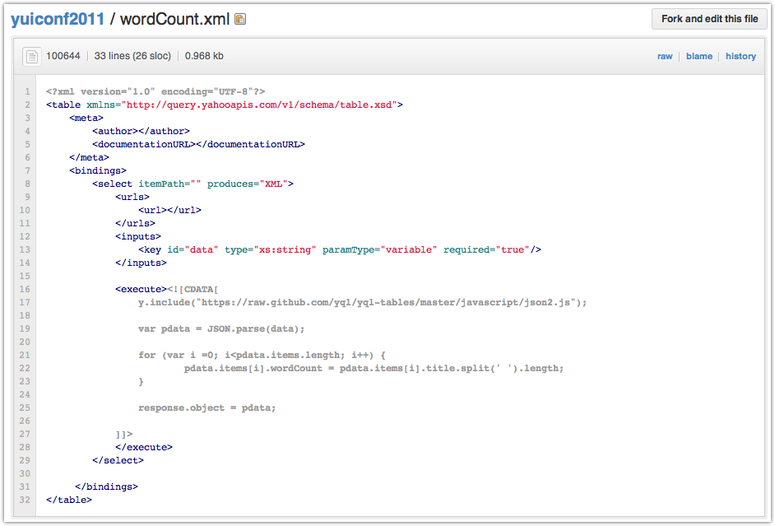
Defining a New Service

Slide 39
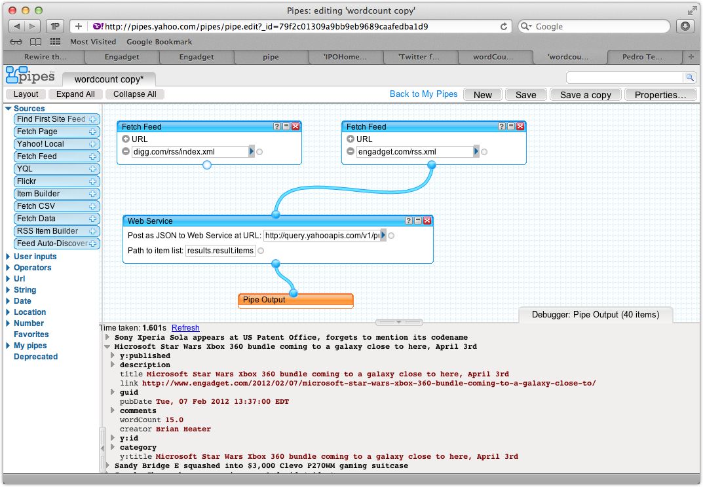
Using the Wordcount Service in Pipes

Slide 40

Yahoo! Query Language (YQL)
The Yahoo! Query Language is an expressive SQL-like language that lets you query, filter, and join data across Web services

Slide 41
http://developer.yahoo.com/yql/console/

Slide 42
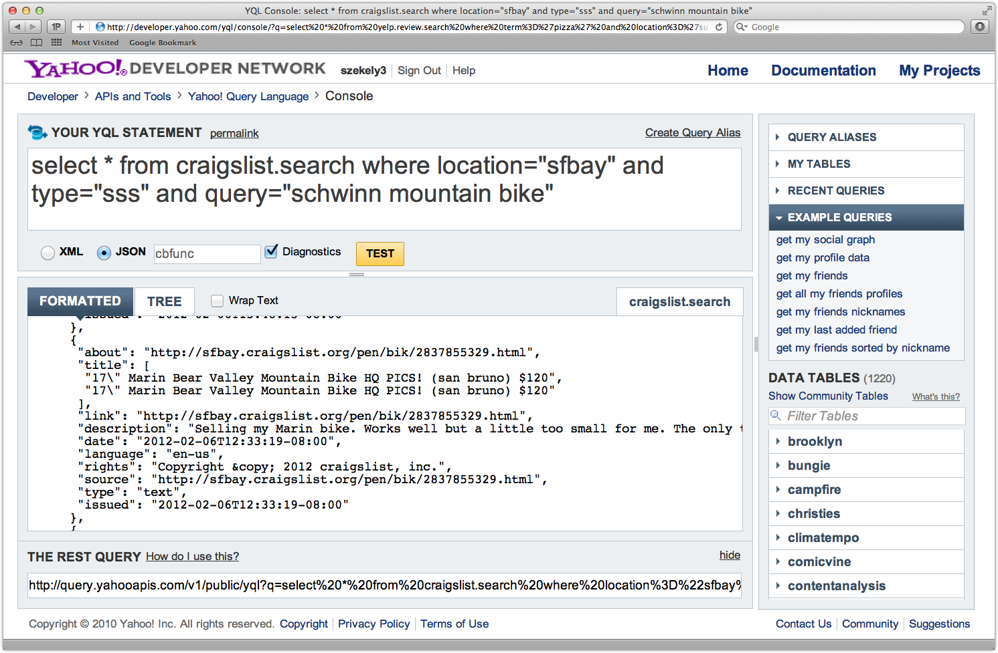

Slide 43

Scrape content from Web pages
Dataflow visual language
Spreadsheet
Integrate sources and services
Publish to Web, maps, databases, …

Slide 44
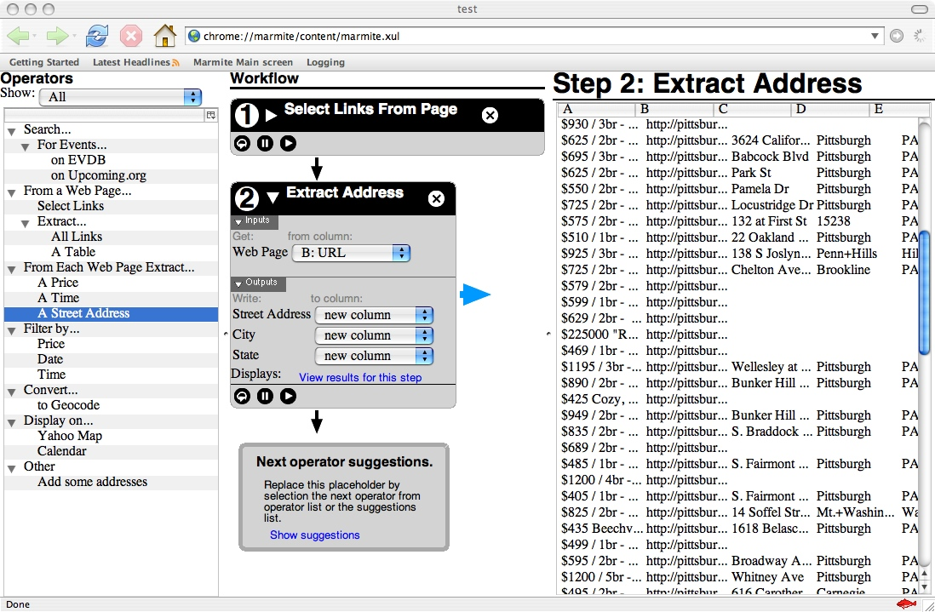
Marmite
Widgets
Workflow
Results

Slide 45
Marmite Evaluation
6 People
2 novices
2 people who know how to use spreadsheet
2 programmers
4 Tasks
Retrieve a set of addresses and geocode an address
Search and filter out events further than a week away
Compile event lists from two services and plot them on a map
Recreate the map from housingmaps.com website

Slide 46
Marmite Result
Novices could not complete any task
Confused about workflow paradigm
3 users completed the 4 tasks in one hour
1 from spreadsheet group
2 programmers
Biggest problem: understanding data flow
Confusion about the input/output concept
Failed to understand that result table is “live”

Slide 47
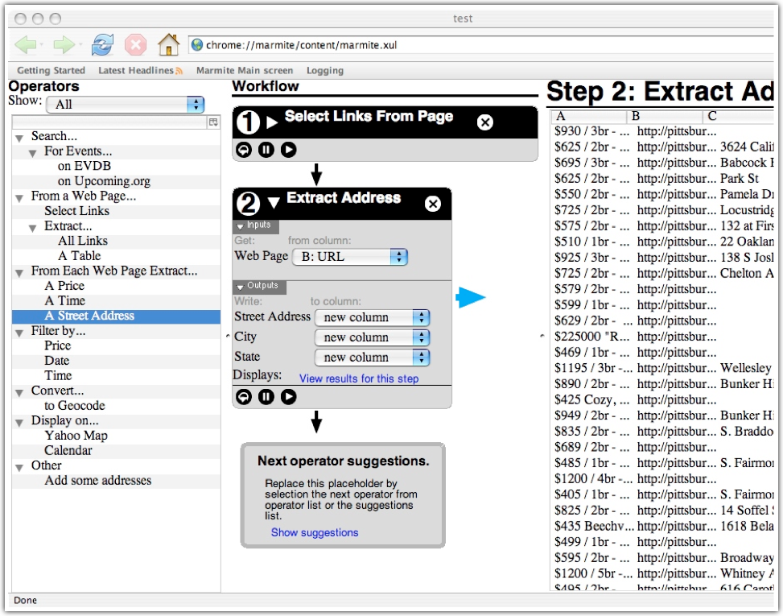

… try the suggestions!
What do I do next?

Slide 48
… you can view the results of any step in the table!
Is my workflow doing the right thing?

Slide 49
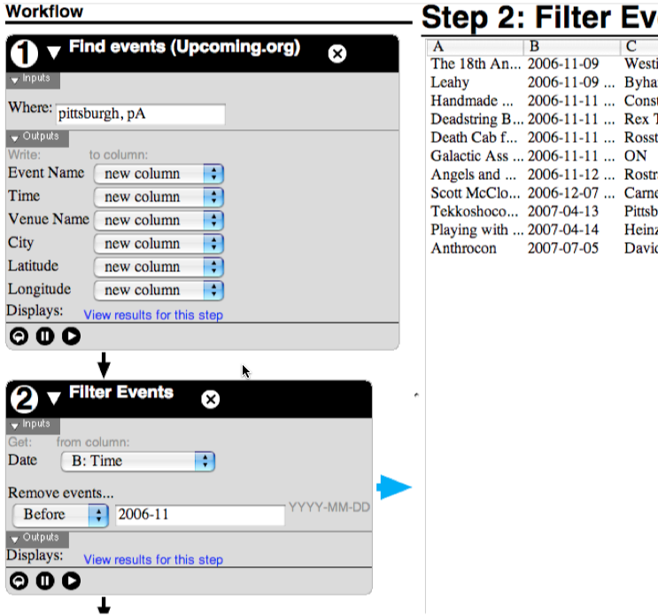
Operators have clearly marked inputs and outputs

Slide 50
To connect them I need to tell you the column?
Sometimes I can fill them for you … based on types

Slide 51
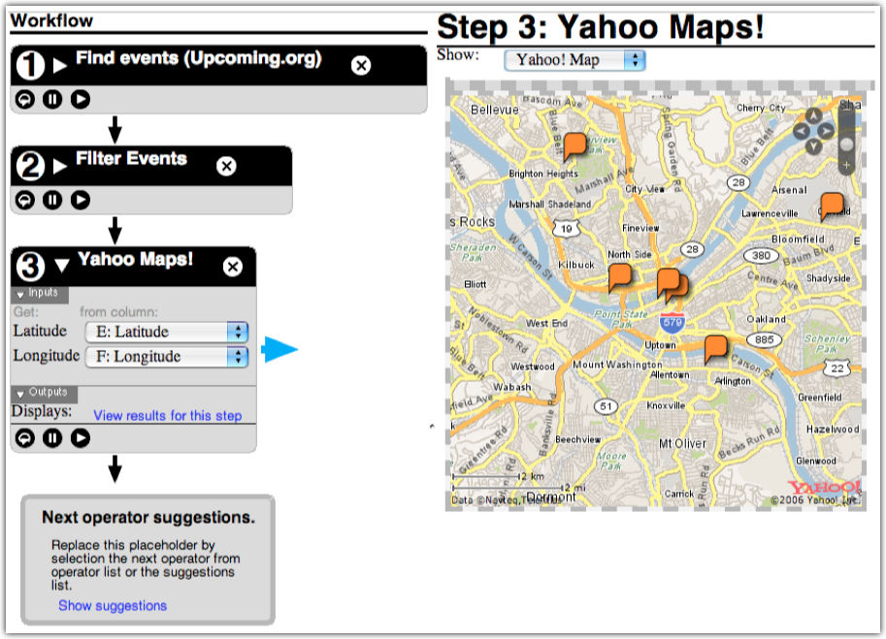
You can do maps!
Indeed, but right now I have only a small library of operators

Slide 52

Marmite Video

Slide 53
Widget-Based Approach
Benefits
Graphical language for programming
Eliminates syntax errors
Issues
Must understand programming concepts
Finding desired widgets is hard
Several tools
Yahoo Pipes
Microsoft Popfly (now defunct)
Marmite
Notes:
Pedro: Doesn’t translate to not having to understand programming.
How about:
- Addresses syntax issued
- But users still required to understand programming concepts

Slide 54
Outline
Interactive Extraction Specification
Interactive Integration Specification
Widget-based Approach to Integration
Programming by demonstration

Slide 55
Programming by Demonstration
Focus on data, not on the process
Users are already familiar with data
Use examples to specify mashup building steps
Consolidate rather than Divide-And-Conquer
Solving one issue can help solve other issues.
Use one interaction platform -- a table
Leverage data models and data instances
Helps with source modeling, cleaning, and data integration.
Notes:
-Leverage existing database --> Mashup can be built on top of each other. So you don’t have to retrieve the data from the web sources
everytime. Seem like a logical approach.

Slide 56
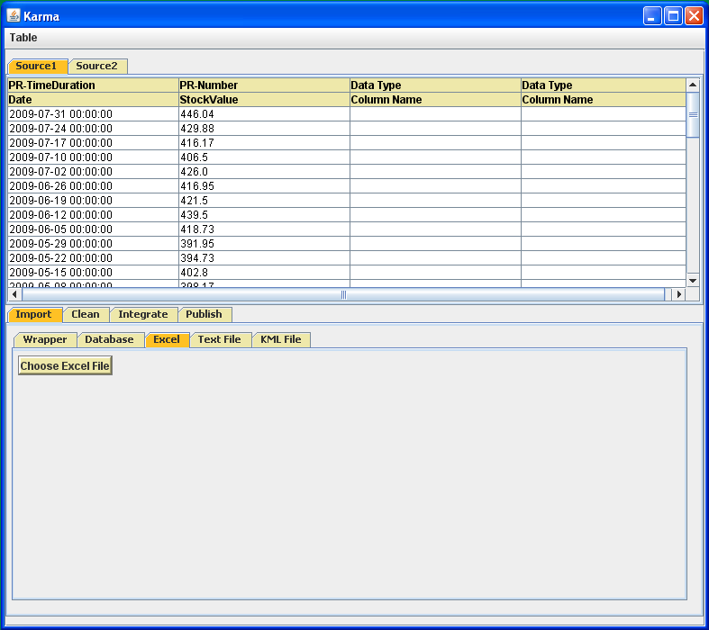
Karma (Our Work)
Data Table – Spreadsheet Type Interface
Various Information Integration Operations
Data Source Types Currently Supported by Karma

Slide 57
Support for Multiple Data Formats
CSV Text File
MySQL Database
Excel Spreadsheet
HTML Web Page

Slide 58
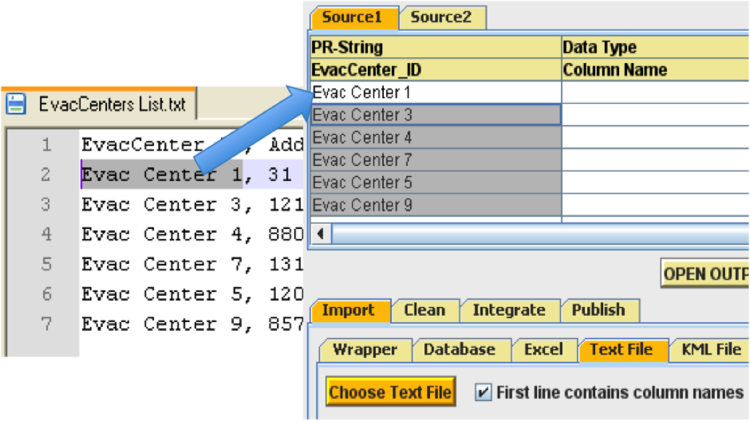
Extraction By Example
Drag and drop a few entries
Karma generalizes to import all entries

Slide 59
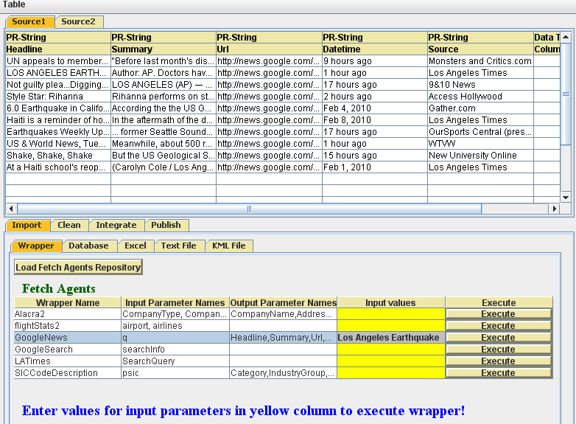
Web Page Extraction Using Wrappers
Iteratively called on all workspace rows
Wrapper Library: Karma lists all the available wrappers on the local machine.

Slide 60
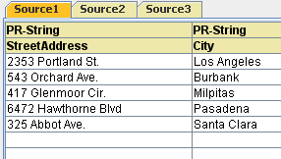
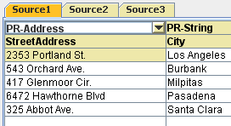
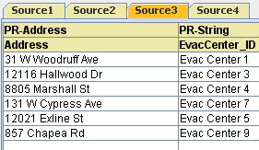
Source Modeling
Automatically infer semantic types for columns
Learn patterns using supervised machine learning
First time Karma encounters address data
Initial Semantic Type unknown
User labels data with appropriate semantic type
Next time Karma encounters address data
Karma learns and automatically assigns semantic type next time

Slide 61
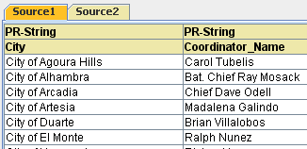
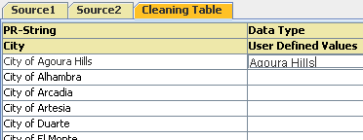
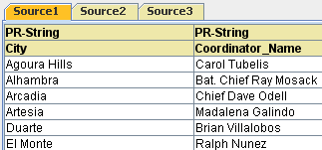
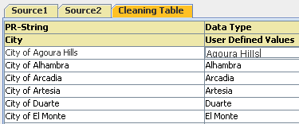
Data Cleaning
Karma learns cleaning rules from examples
Initial data source
User provides example
Data source after cleaning
Karma applies the learned transformation rules over remaining data

Slide 62
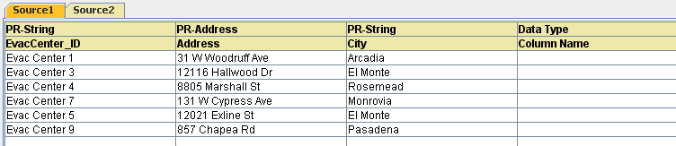
Data Integration
Karma suggests potential joins with other sources
Matching semantic type and column names
Column completion

Slide 63
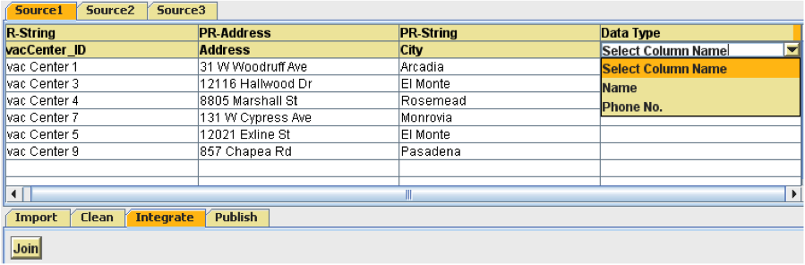
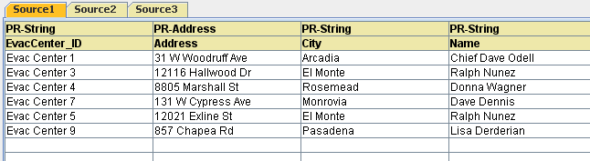
Data Integration
Karma suggests new columns in a drop down list
MySQL Database loaded as a another source in Karma
Karma generates and executes join queries

Slide 64
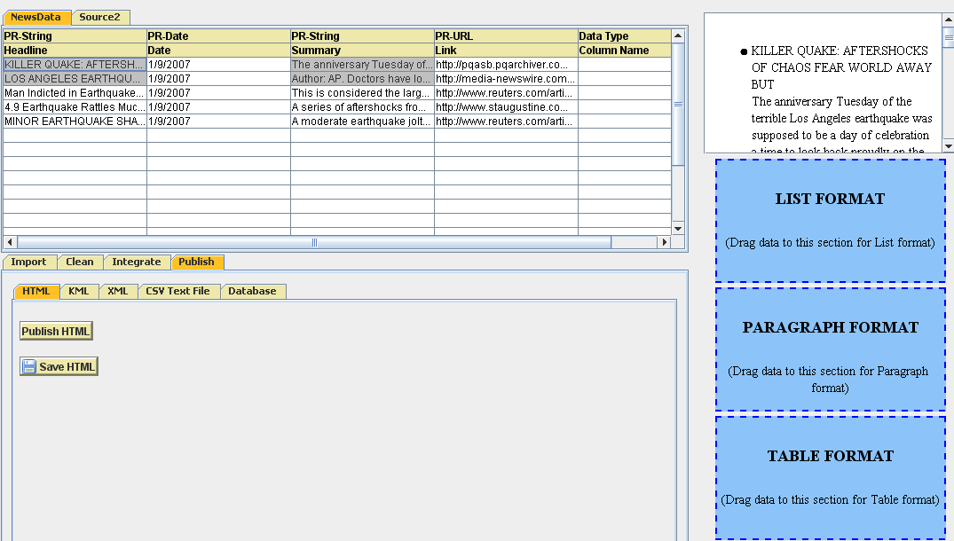
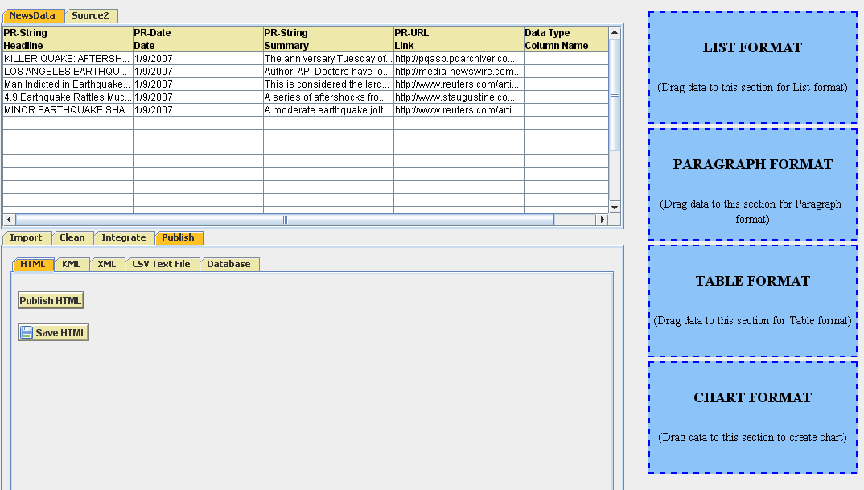

Visualization By Demonstration
Visualization by example using a drag and drop
Preview Generated
Output Preview Window

Slide 65


Data Visualization: 4 Types
Charts
Paragraph

Slide 66


Data Visualization: 4 Types
Lists
Tables

Slide 67

Data Publication: Multiple Formats
HTML Page
Database table
KML Layer
XML File
CSV Text File
Different mashup publishing options

Slide 68

Automatic Detection and Geocoding of Geospatial References
Geospatial references automatically detected using semantic types.
Google geocoding service used to get coordinates.
Markers are placed on those coordinates in the final mashup.

Slide 69

Mashup Data Visualized on Maps

Slide 70

Karma Video

Slide 71
Tradeoffs in each approach
Interactive Extraction Specification: Piggy bank
Pro: Turns Web sites into structured data with library of extractors
Con: Requires an expert to create new extractors
Interactive Integration Specification: Mashmaker
Pro: Flexible, browser-based integration
Con: Requires an expert to add new functionality
Widget-based Approach: Yahoo Pipes & Marmite
Pro: Easy integration of capabilities
Con: Dataflow model is difficult for users to understand
Programming by Demonstration: Karma
Pro: Easy for users to specify integration
Con: May not work on all web sites

